Slide 1


Product Recommendation System in C++
Graph-based approach for suggesting products to users.
Notes:
1

Slide 2

Project Overview
What is the Project about
How its done
Enhancing user experience by suggesting products based on their interactions.
Using Graphs where nodes represent users and products
Edges represent interactions b/w users and products
Example: E-commerce services like Flipkart
Notes:
2

Slide 3
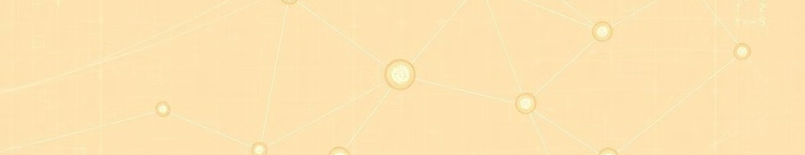



Key Components
Recommendation Algorithm
Graph Structure
Product Class
Nodes are used to store users and products, edges for interactions.
Stores product details like name, category, price and description which user requires
Uses BFS(Breadth first search) algorithm to suggest products based on user interests.
Notes:
3

Slide 4
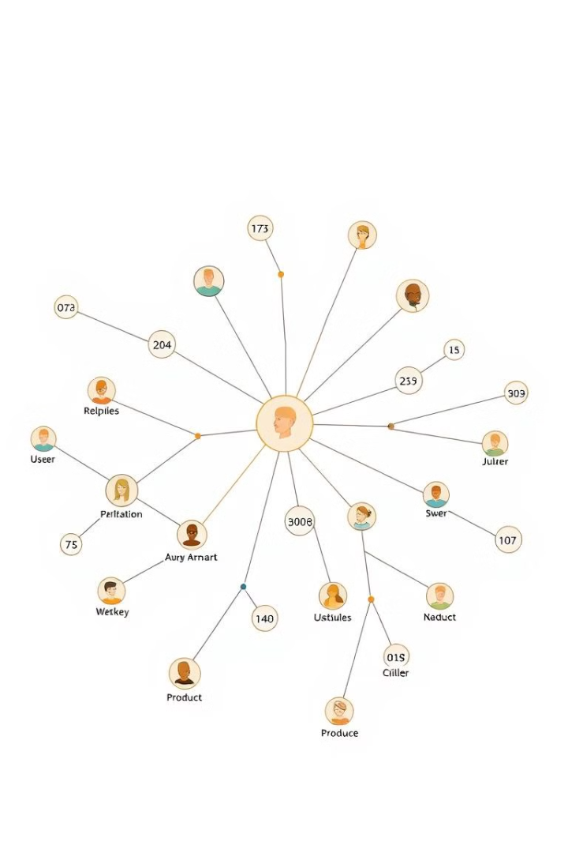
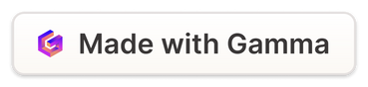
How the Graph Works
Nodes
Edges
Represent users and products in the system.
Show interactions between users and products.
Weights
Goal
Indicate interaction strength, like ratings out of 5.
Find products closely connected to user preferences.
Notes:
4

Slide 5
Product Class Details
Attribute
Description
productName
Name of the product
category
Type of product (e.g., electronics)
price
Cost of the product
description
Brief product description
Notes:
5

Slide 6
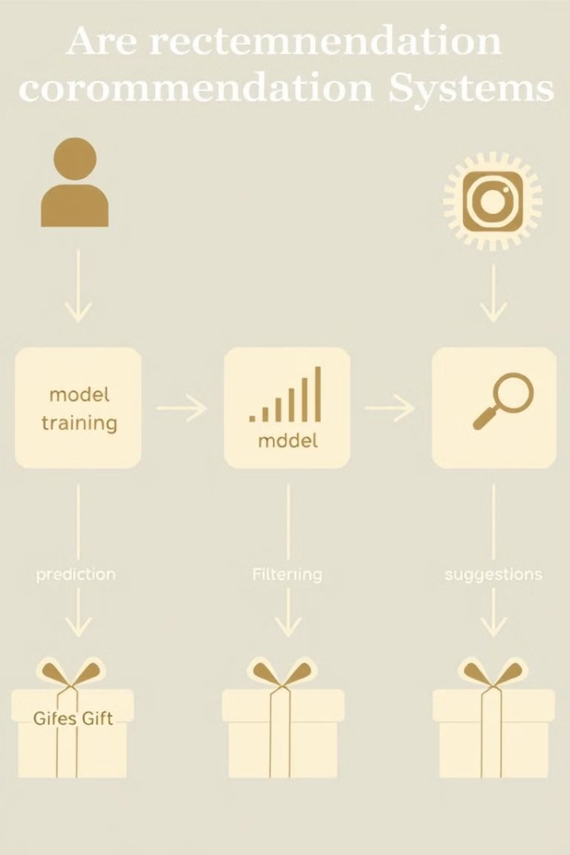
Core Functionalities
1
Add Users and Products
Build network of users and products in graph.
2
User-Product Interactions
Record ratings as edges with weights.
3
Recommendations
Use BFS to find and rank related products.
Notes:
6

Slide 7
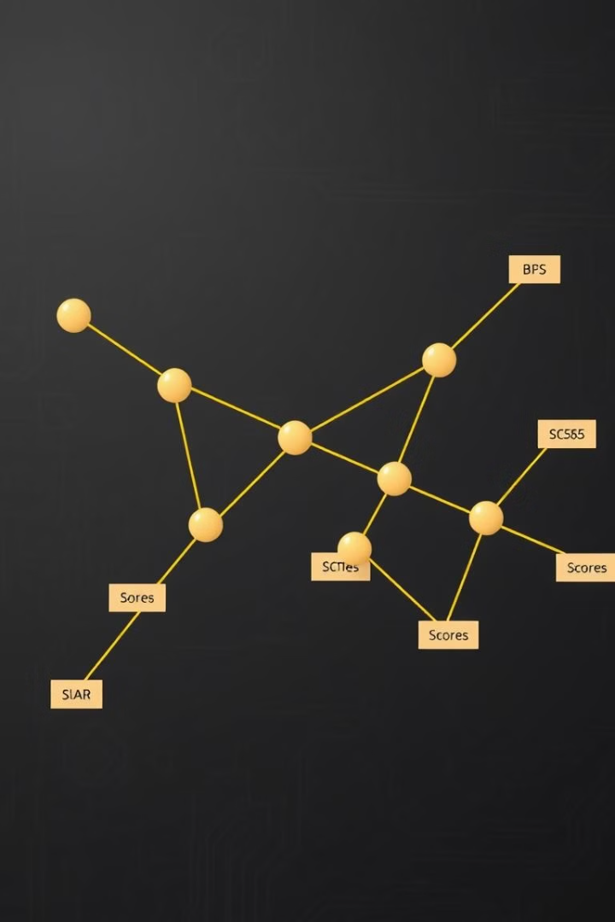
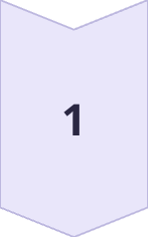
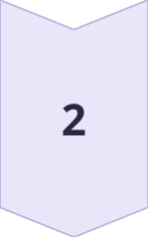
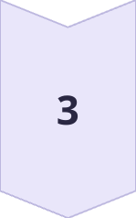
Recommendation Logic
BFS Traversal
Start from target user, explore connections to products.
Product Scoring
Score products based on interaction weight and distance.
Top Recommendations
Output set number of highest-scoring products for user.
Notes:
7

Slide 8
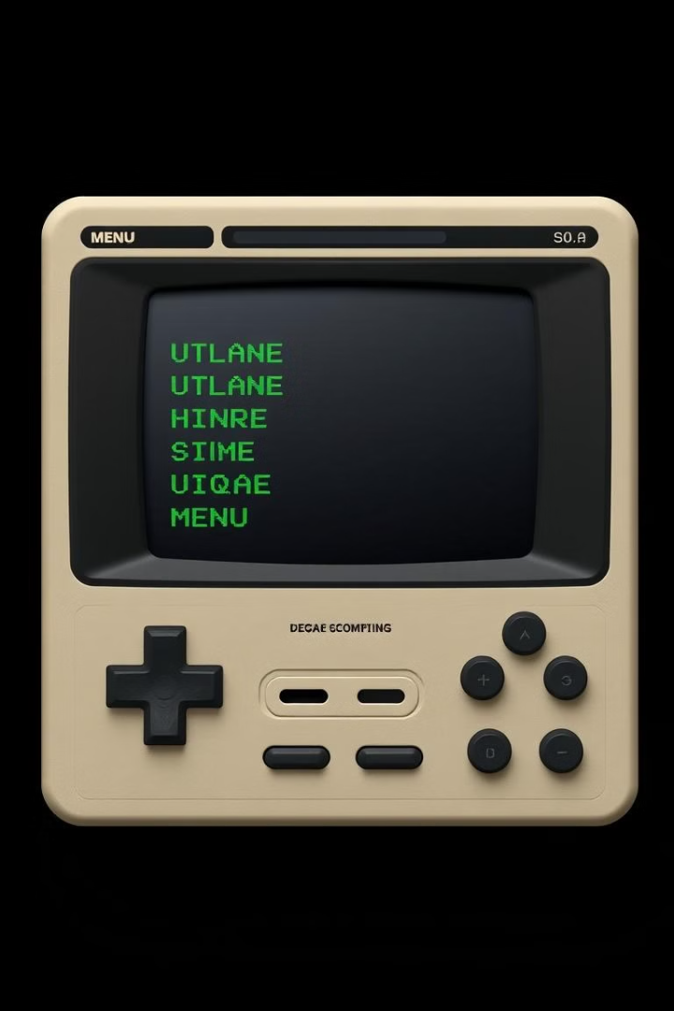
Interactive Console Menu
1
Get Recommendations
2
Manage Products
Display, update, or remove product details.
Retrieve personalized product suggestions for users.
3
Debug Options
4
User Experience
Display graph structure for system verification.
Clear prompts and feedback for each action.
Notes:
8

Slide 9
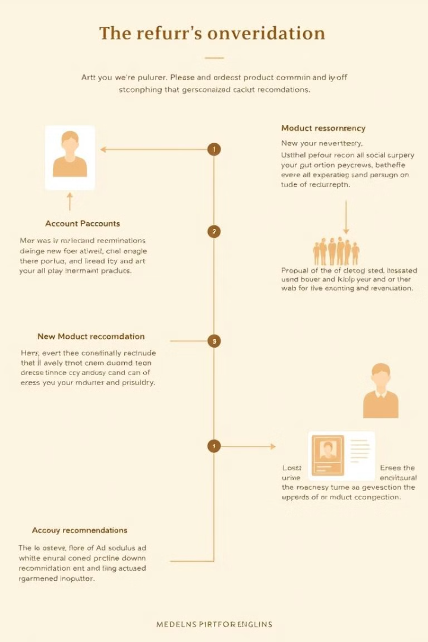
Example Usage
Add Users
1
Create profiles for Alice and Bob.
Add Products
2
Input details for Phone and Headphones.
Record Interactions
3
Alice rates Phone as 5 stars.
Get Recommendations
4
System suggests products for Alice.
Notes:
9

Slide 10
Header Files used in this project
#include <iostream>
#include <unordered_map> #include <vector>
#include <queue>
#include <set>
#include <string>
#include <limits>
#include <fstream>
#include <algorithm>

Slide 11
Functions used in this project
vo
void addNode()
void addEdge()
bool containsNode()
void displayGraph()
int getIntInput()
double getDoubleInput()
string getStringInput()
Product createProduct()
void removeProduct()
void updateProduct()
void displayAllProducts()
void displayProductDetails()

Slide 12
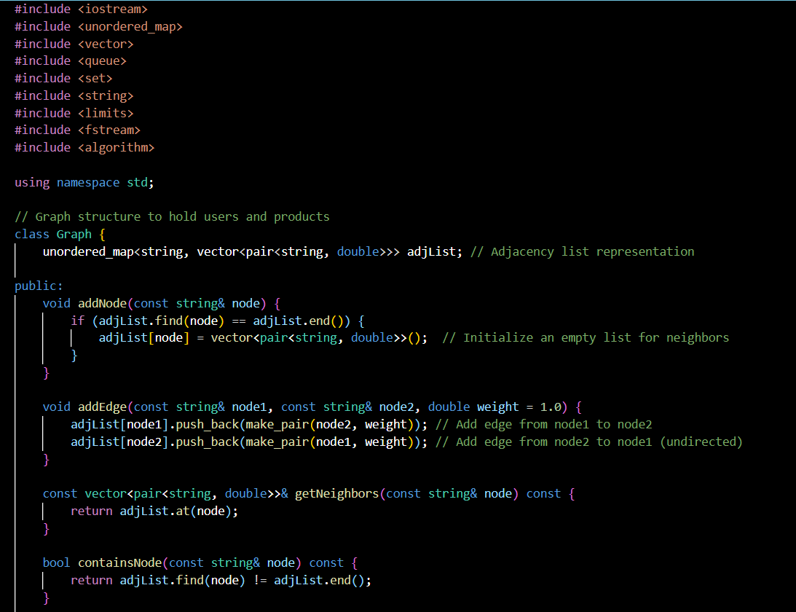
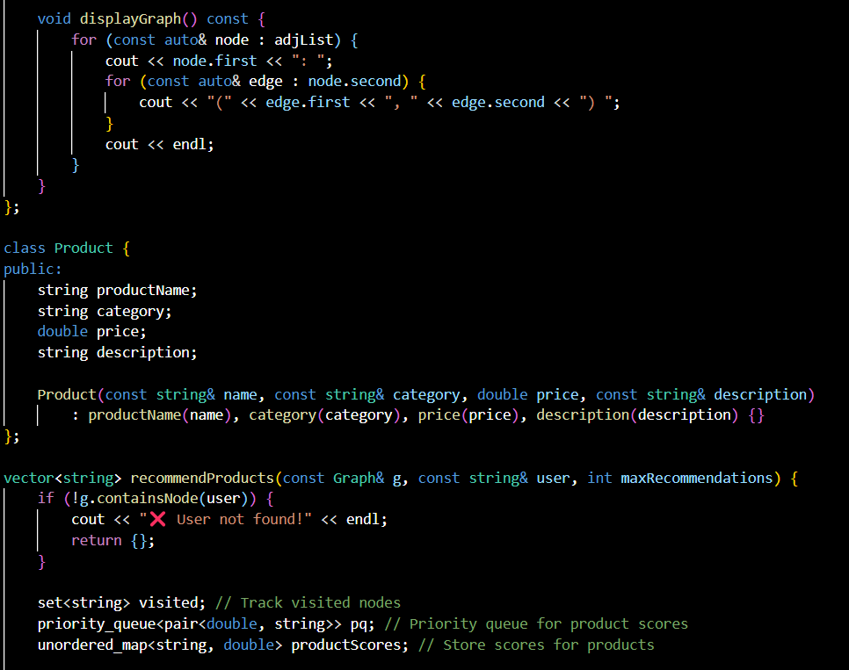
SOURCE CODE

Slide 13
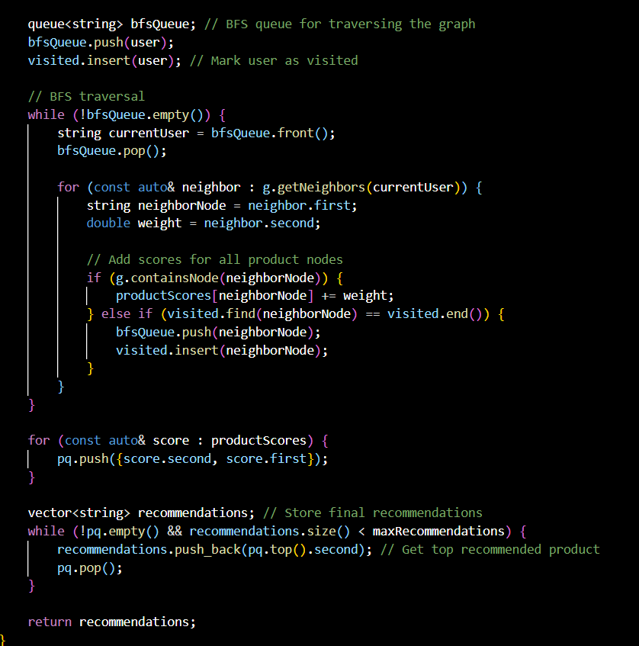
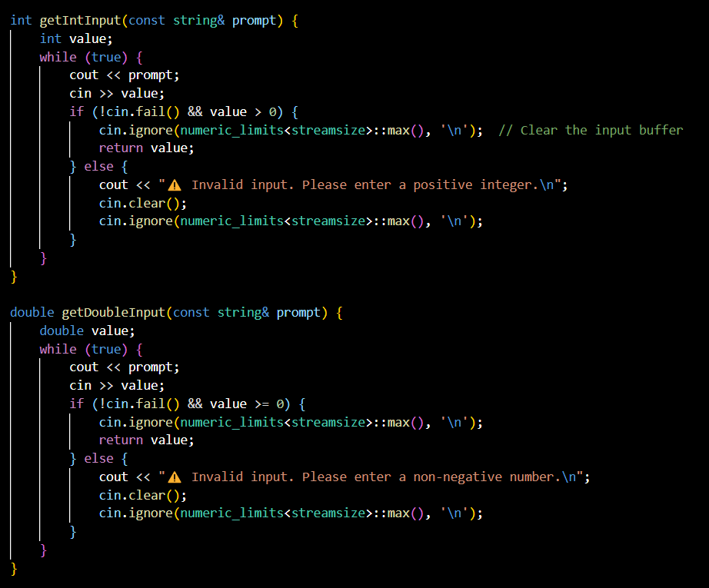
SOURCE CODE

Slide 14
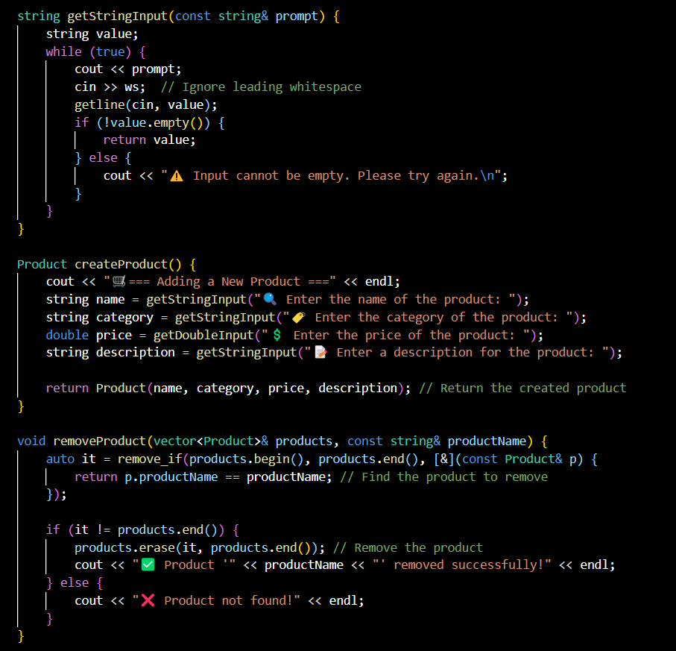
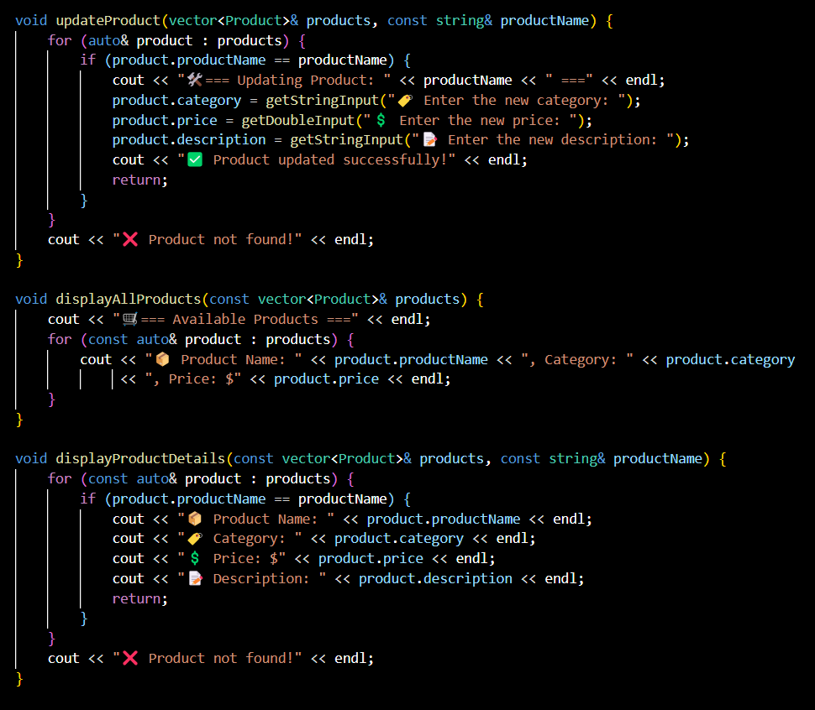
SOURCE CODE

Slide 15
SOURCE CODE

Slide 16
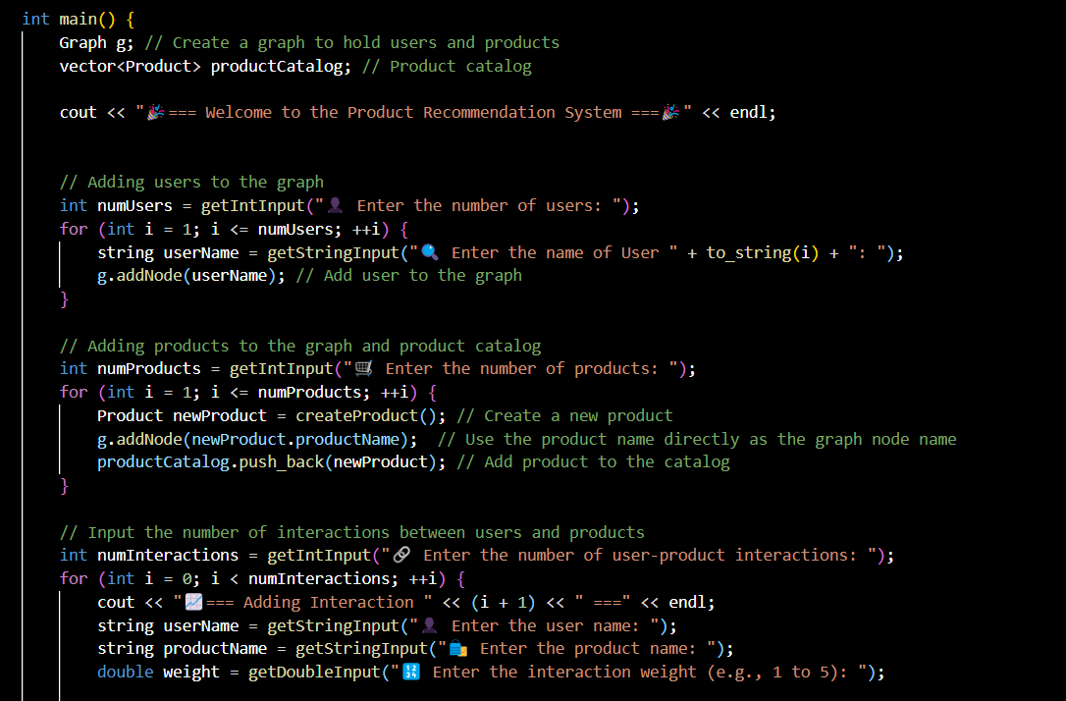
SOURCE CODE

Slide 17
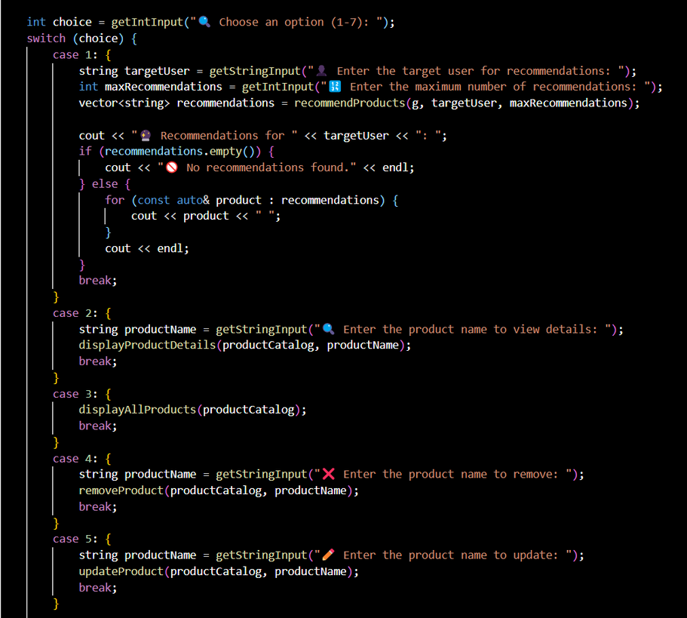
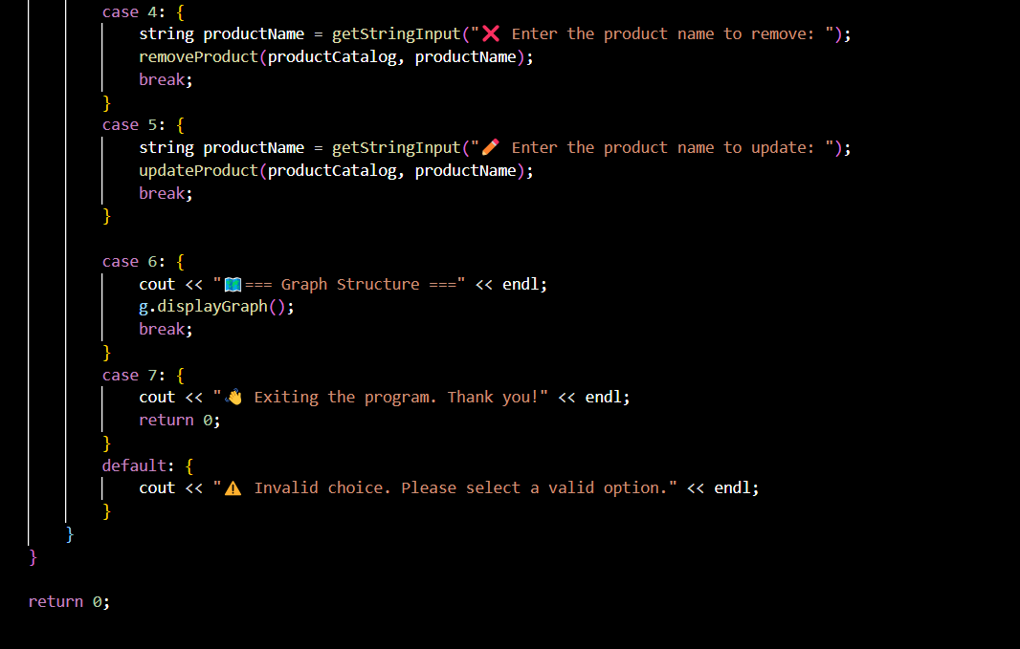
SOURCE CODE

Slide 18
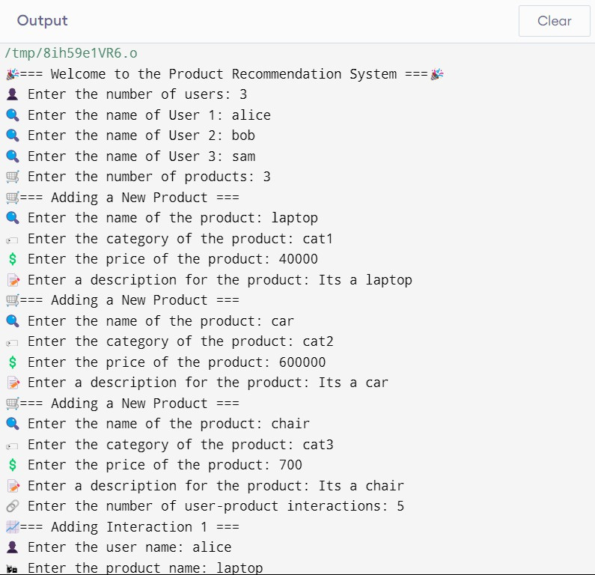
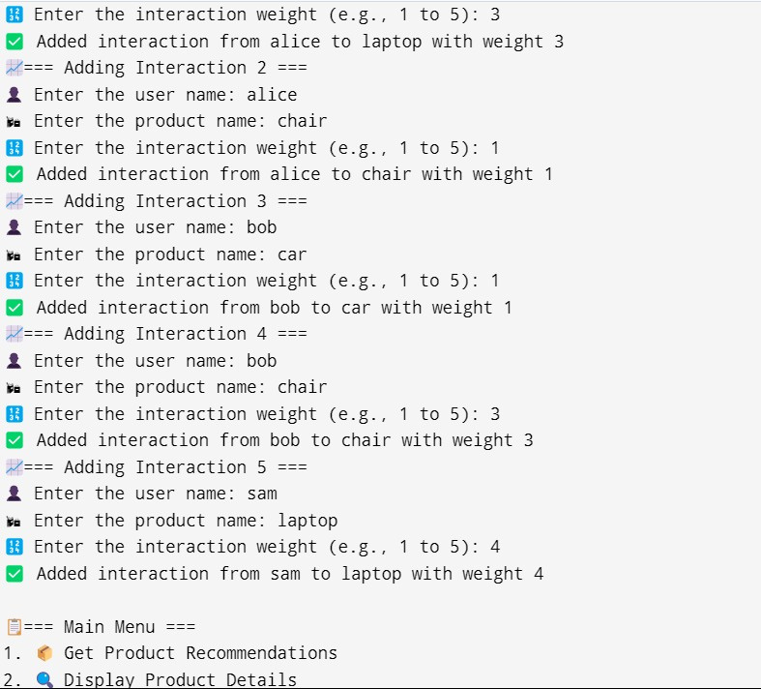
Sample output test cases
Adding User or Product
Adding Interactions

Slide 19
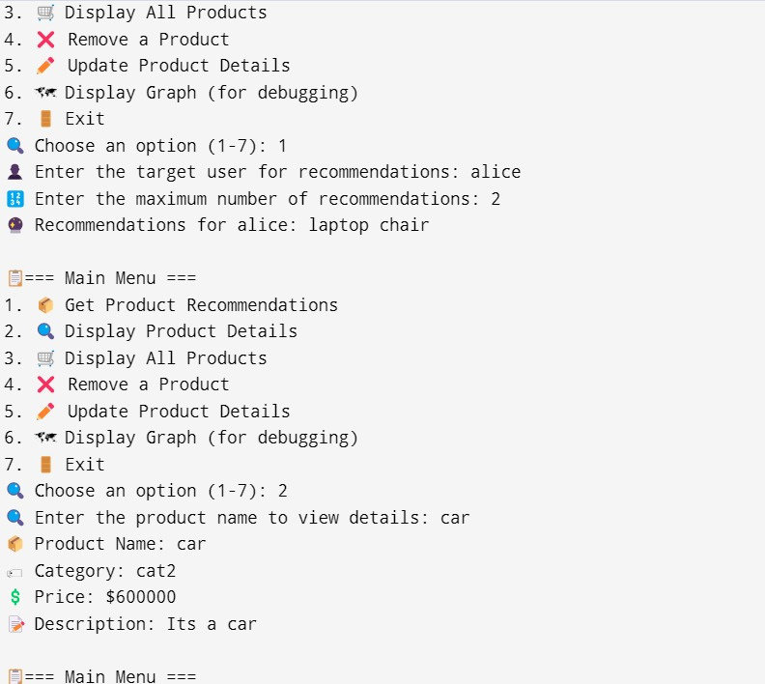
Console Menu
Getting Product Recommendations
Displaying Product Details

Slide 20
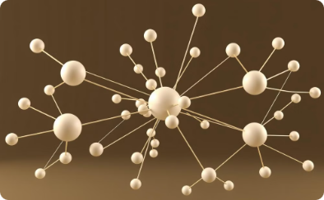
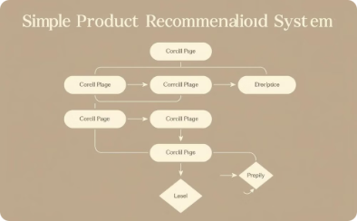
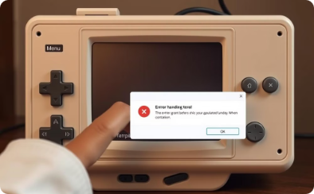
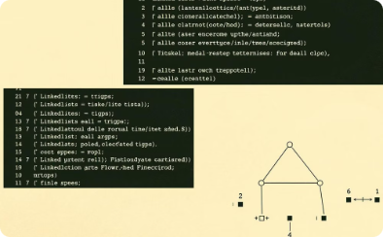
Key Takeaways
Graph Data Structure
Recommendation Logic
User Interaction
Skills Demonstrated
Efficiently models relationships between users and products.
Interactive and robust with comprehensive error handling.
Showcases graph traversal, data handling, and C++ programming.
Simple yet effective way to suggest relevant products.
Notes:
14

Slide 21
THANK YOU
DONE BY : P. Yaswanth (AP23110010511)
P. Sudarshan (AP23110010531)
A. Viswaj (AP23110010564)
SK. Ismael (AP23110010569)
Notes:
1

